Slide 1
Could Planets orbiting Red Dwarf Stars support Oxygenic Photosynthesis and hence Complex Life? - A reappraisal and update.
Joe Gale
Institute of Life Sciences
The Hebrew University of Jerusalem
ILASOL 2013

Slide 2
Why was Oxygen so essential for the Evolution of Complex Life on Earth?
Oxygen (and hence ozone) produced by oxygenic photosynthesis absorbs UV. Allowed life to emerge from the sea to land.
Enabled aerobic respiration.

Slide 3
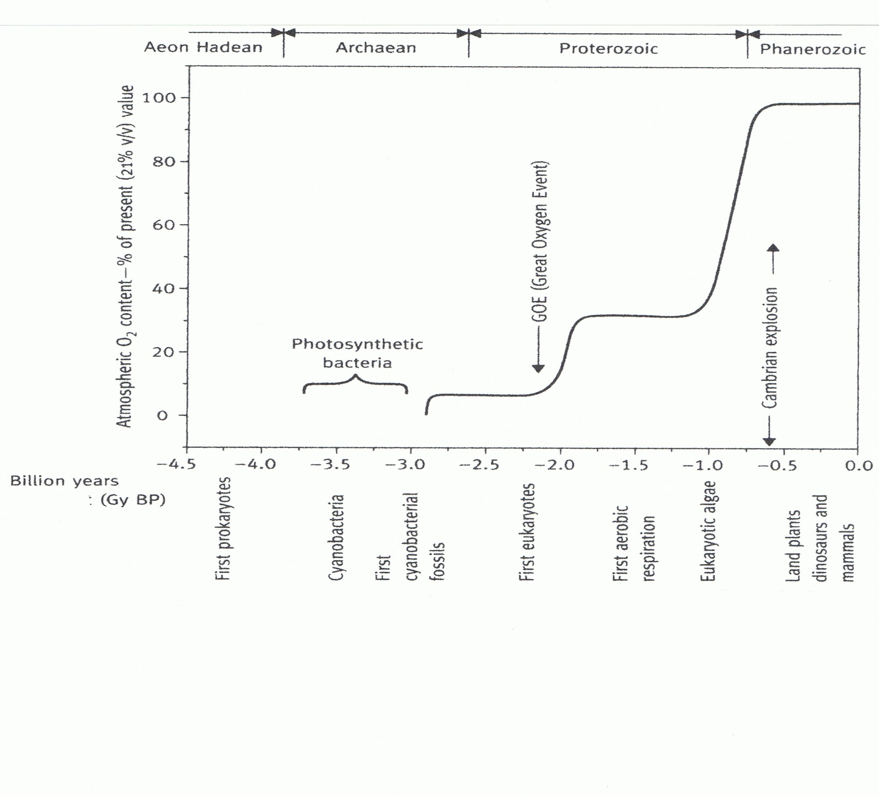
IIIi
“
High Oxygen, enabling
Aerobic Respiration
Cambrian “Explosion”
Early Ice Age
First
Non-Oxygenic
First
Eukaryotic
Green algae
Oxygenic Photosynthesis and the Evolution of
Earth’s Atmosphere and Complex Life

Slide 4
Why Oxygenic Photosynthesis and Complex Life on Red Dwarf (RD) orbiting Planets are possible:
Although most stars orbit each other in groups of two or three, planets orbiting one or more stars may have strange, but not life impossible climates (2 or three Suns).
RDs are long lived – an apparent requirement for the evolution of complex life forms.
Although early RD star life is characterized by flares and much UV, they are later more quiescent.
Tidally locked planets have been calculated to have quite mild climates, with winds not exceeding 5-10m s⁻¹, even at the Terminator.
EMR radiation of RDs contains much energy in the 300-400nm PAR (Photosynthetically Active Radiation) waveband.
There is no theoretical cut off for PAR at 700nm. It could extend into the NIR of RD radiation.
Earth benefits from the stabilizing effect of a massive Moon. Tidal locking would ensure orbital stability. No Moon required!

Slide 5
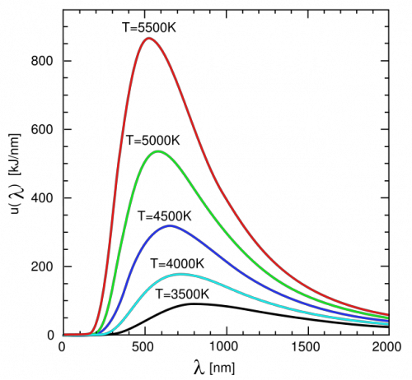
Radiation as a function of Black Body Temperature
Waveband of Oxygenic Photosynthesis
Note: Sun’s surface temperature
~ 5,800ºK
Red Dwarf Stars

Slide 6
Radiation as a function of Black Body Temperature (Wien’s Law)
Waveband of Oxygenic Photosynthesis
Radiation in Photosynthetic
waveband

Slide 7
First Life and Photosynthesis evolved in water.
Below 10cm depth, life is protected by water absorbance of UV.
Plants could not leave this environment, for land, before the emergence of an oxygen/ozone (+water vapour) atmosphere – which absorbs most UV.
Water below a depth of ~15cm transmits little NIR. No ecological pressure to evolve NIR exploiting photosynthesis pigments.

Slide 8
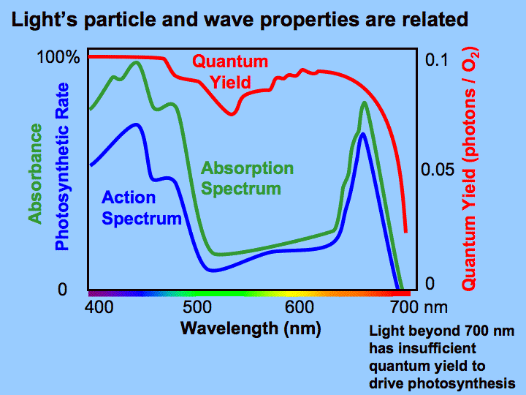
Action / Absorption Spectra of Chlorophyll carrying out Oxygenic Photosynthesis
??

Slide 9
Is Photolysis of water Limited to Wavelengths < 700nm??
Standard emf for water charge separation – 1.23 eV (theoretical limit in a reversible system, at STP and pH – 0)
Quantum Energy at 680nm – 1.82eV
700nm – 1.77
870nm – 1.5
1,009nm – 1.23
Main Restraint above 700nm – lowered efficiency (in terms of photons used – the current Z scheme utilizes a minimum of 8 photons in the fixation of one CO₂ molecule, but usually 12, including use for cyclic photophosphorylation, N₂ fixation, etc.).
Upconversion (Anti-Stokes emission): in which absorption of two or more photons leads to emission at shorter wavelength is possible, but at low efficiency.*
*Wang et al 2013
So Why has Earth based Photosynthesis of Land Plants not evolved to use the ~30% of the Suns EMR between 700 – ~900nm?

Slide 10
Crick’s querty explanation - THE genetic code, with its four basis’, is the one combination which gives the least number of errors on replication. The standard set of ~20 amino acids are not those which would appear by random*. - In photosynthesis, Ron Milo** calculated THAT THE 680-700nm absorbing reaction centers MAXIMIZE charge separation EFFICIENCY in terms of photons used. Evolutionary Conservatism in photosynthesis is not absolute: e.g- leaves of higher plants have evolved to transmit and reflect NIR and thus reduce water loss. Evidently this was often of greater adaptive value than More photosynthesis. * philip and freeland – Astrobiology, 11:235-40, 2011 ** Milo –PHOTOSYN. Res. 101:59-67, 2009
Genetic code and Photosynthesis conservatism

Slide 11
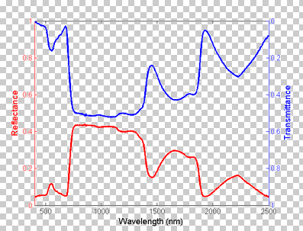
Optical properties of average leaves, which evolved on
Earth, in the Near Infra Red.
Low Absorbance
An adaptation which reduces plant water loss. Little ecological pressure to evolve NIR photosyn..

Slide 12
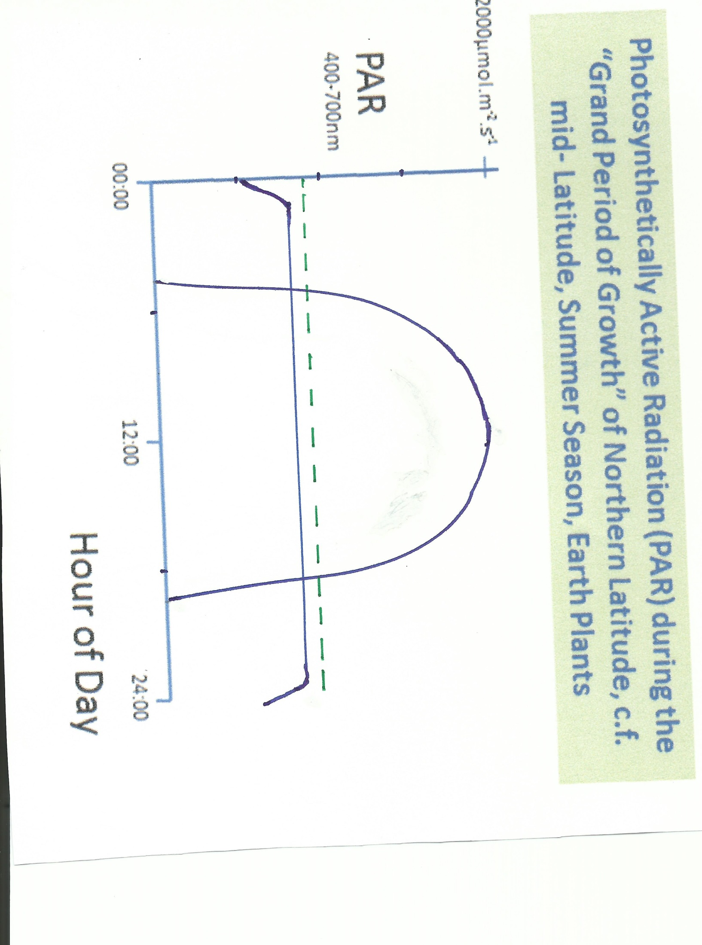
30ºLatitude
Solar EMR above Pmax. Water use increases.
Photos. may decline.
PAR at Pmax
(Maximum
P Rate)
80ºLatitude
Star facing side of
RD orbiting planets
would be exposed
to continuous irradiation. Some regions, before the
Terminator, would receive optimum PAR intensity.
NOT TO SCALE

Slide 13
Conclusions on the presence of Earth-like and NIR Oxygenic Photosynthesis on Red Dwarf orbiting planets
Possible and Likely
Complex Life could evolve.
Intelligent Life??
Although time-wise the evolution (on Earth) from first land life to Intelligent Civilizations was short (0.5Gy) it was a highly unlikely, statistically improbable event.

Slide 14
“Update – November 26, 2013”
From analysis of Kepler data on ~ 600, G (sunlike) Stars
22% of Sun-like G stars –estimated to have at least one Earth mass, HZ planet: a total of ??G in the Milky Way Galaxy ( Petigura, et al, Proc. Nat. Ac. Sc. 110: 19273-8).
The existence in the Milky Way Galazy of life and even technologically competent, communicating civilizations on RD and G stars is of much higher probability than previously thought – back to Fermi’s Paradox!
BUT, Caveat Emptor!!
Close-up study of extra Solar Systems, by visiting starships or probes, to confirm the above speculations, and two way communication with another Civilization, are not feasible with the most optimistic projection of today’s science and technology.
Tomorrow????

