Slide 1
Intercultural Knowledge & Competence & Global Learning Rubrics
Chris Cartwright, EdD
Director of Intercultural Assessment
Intercultural Communication Institute

Slide 2
Participants will:
Familiar
Developed
Access
Sample
Discuss
Notes:
Become familiar with the rubric
Learn how the rubric was developed
Learn how to access the rubric
View sample student work samples
Discuss how it might be used on their campuses or organizations

Slide 3
Intercultural Knowledge & Competence Metarubric
Knowledge
Skills
Attitudes

Slide 4
Intercultural Knowledge & Competence Metarubric
http://www.aacu.org/
value/rubrics/index.cfm

Slide 5
Essential Learning Outcomes
Knowledge of Human Cultures and the Physical and Natural World
Intellectual and Practical Skills
Personal and Social Responsibility
Integrative and Applied Learning
Notes:
Knowledge of Human Cultures and the Physical and Natural World
Through study in the sciences and mathematics, social sciences, humanities, histories, languages, and the arts
Focused by engagement with big questions, both contemporary and enduring
Intellectual and Practical Skills, Including
Inquiry and analysis
Critical and creative thinking
Written and oral communication
Quantitative literacy
Information literacy
Teamwork and problem solving
Practiced extensively, across the curriculum, in the context of progressively more challenging problems, projects, and standards for performance
Personal and Social Responsibility, Including
Civic knowledge and engagement—local and global
Intercultural knowledge and competence
Ethical reasoning and action
Foundations and skills for lifelong learning
Anchored through active involvement with diverse communities and real-world challenges
Integrative and Applied Learning, Including
Synthesis and advanced accomplishment across general and specialized studies
Demonstrated through the application of knowledge, skills, and responsibilities to new settings and complex problems

Slide 6
VALUE
Valid
Assess
Learning
Multiple
E-portfolios
Notes:
VALUE assumes that:
to achieve a high-quality education for all students,
valid assessment data are needed to guide planning, teaching, and improvement;
colleges and universities seek to foster and assess numerous essential
learning outcomes beyond those addressed by currently available
standardized tests;
learning develops over time and should become more complex and
sophisticated as students move through their curricular and cocurricular
educational pathways toward a degree;
good practice in assessment requires multiple assessments, over time should become more complex and
sophisticated; well-planned electronic portfolios provide opportunities to collect data from multiple assessments across a broad range of learning outcomes while guiding student learning and building self-assessment capabilities;
eportfolios and assessment of work in them can inform programs and
institutions on progress in achieving expected goals.

Slide 7
Project Description
Grants
State Farm Companies Foundation
Fund for the Improvement of Postsecondary Education,
Time-Line
May 2007 through April 2010.
Selected 15 teams
100 faculty & other academic professionals
Assembled
Collect rubrics for ascending levels of accomplishment
Tested
3 times
100 campuses
Notes:
Supported by grants from The State Farm Companies Foundation and the Fund for the Improvement of Postsecondary Education, the project runs May 2007 through April 2010.
AAAC&U staff, the advisory board and selected teams of faculty and other academic professionals are assembling a collection of rubrics for ascending levels of accomplishment.

Slide 8
High-Impact Educational Practices
First-Year Seminars & Experiences
Common Intellectual Experiences
Learning Communities
Writing-Intensive Courses
Collaborative Assignments & Projects
Undergraduate Research
Diversity/Global Learning
Service Learning, Community-Based Learning
Internships
Capstone Courses & Projects
Notes:
High-Impact Educational Practices
A Brief Overview
Excerpt from High-Impact Educational Practices: What They Are, Who Has Access to Them, and Why They Matter, by George D. Kuh (AAC&U, 2008)
Part 1 - High-Impact Educational Practices: A Brief Overview
The following teaching and learning practices have been widely tested and have been shown to be beneficial for college students from many backgrounds.10 These practices take many different forms, depending on learner characteristics and on institutional priorities and contexts.
On many campuses, assessment of student involvement in active learning practices such as these has made it possible to assess the practices’ contribution to students’ cumulative learning. However, on almost all campuses, utilization of active learning practices is unsystematic, to the detriment of student learning. Presented below are brief descriptions of high-impact practices that educational research suggests increase rates of student retention and student engagement. The rest of this publication will explore in more detail why these types of practices are effective, which students have access to them, and, finally, what effect they might have on different cohorts of students.
First-Year Seminars and Experiences
Many schools now build into the curriculum first-year seminars or other programs that bring small groups of students together with faculty or staff on a regular basis. The highest-quality first-year experiences place a strong emphasis on critical inquiry, frequent writing, information literacy, collaborative learning, and other skills that develop students’ intellectual and practical competencies. First-year seminars can also involve students with cutting-edge questions in scholarship and with faculty members’ own research.
Common Intellectual Experiences
The older idea of a “core” curriculum has evolved into a variety of modern forms, such as a set of required common courses or a vertically organized general education program that includes advanced integrative studies and/or required participation in a learning community. These programs often combine broad themes—e.g., technology and society, global interdependence—with a variety of curricular and cocurricular options for students.
Learning Communities
The key goals for learning communities are to encourage integration of learning across courses and to involve students with “big questions” that matter beyond the classroom. Students take two or more linked courses as a group and work closely with one another and with their professors. Many learning communities explore a common topic and/or common readings through the lenses of different disciplines. Some deliberately link “liberal arts” and “professional courses”; others feature service learning.
Writing-Intensive Courses
These courses emphasize writing at all levels of instruction and across the curriculum, including final-year projects. Students are encouraged to produce and revise various forms of writing for different audiences in different disciplines. The effectiveness of this repeated practice “across the curriculum” has led to parallel efforts in such areas as quantitative reasoning, oral communication, information literacy, and, on some campuses, ethical inquiry.
Collaborative Assignments and Projects
Collaborative learning combines two key goals: learning to work and solve problems in the company of others, and sharpening one’s own understanding by listening seriously to the insights of others, especially those with different backgrounds and life experiences. Approaches range from study groups within a course, to team-based assignments and writing, to cooperative projects and research.
Undergraduate Research
Many colleges and universities are now providing research experiences for students in all disciplines. Undergraduate research, however, has been most prominently used in science disciplines. With strong support from the National Science Foundation and the research community, scientists are reshaping their courses to connect key concepts and questions with students’ early and active involvement in systematic investigation and research. The goal is to involve students with actively contested questions, empirical observation, cutting-edge technologies, and the sense of excitement that comes from working to answer important questions.
Diversity/Global Learning
Many colleges and universities now emphasize courses and programs that help students explore cultures, life experiences, and worldviews different from their own. These studies—which may address U.S. diversity, world cultures, or both—often explore “difficult differences” such as racial, ethnic, and gender inequality, or continuing struggles around the globe for human rights, freedom, and power. Frequently, intercultural studies are augmented by experiential learning in the community and/or by study abroad.
Service Learning, Community-Based Learning
In these programs, field-based “experiential learning” with community partners is an instructional strategy—and often a required part of the course. The idea is to give students direct experience with issues they are studying in the curriculum and with ongoing efforts to analyze and solve problems in the community. A key element in these programs is the opportunity students have to both apply what they are learning in real-world settings and reflect in a classroom setting on their service experiences. These programs model the idea that giving something back to the community is an important college outcome, and that working with community partners is good preparation for citizenship, work, and life.
Internships
Internships are another increasingly common form of experiential learning. The idea is to provide students with direct experience in a work setting—usually related to their career interests—and to give them the benefit of supervision and coaching from professionals in the field. If the internship is taken for course credit, students complete a project or paper that is approved by a faculty member.
Capstone Courses and Projects
Whether they’re called “senior capstones” or some other name, these culminating experiences require students nearing the end of their college years to create a project of some sort that integrates and applies what they’ve learned. The project might be a research paper, a performance, a portfolio of “best work,” or an exhibit of artwork. Capstones are offered both in departmental programs and, increasingly, in general education as well.

Slide 9
Intercultural Knowledge & Competence Rubric Development Team
Janet Bennett, Intercultural Communication Institute
Kimberley Brown, Portland State University
Chris Cartwright, Portland State University
Margaret Davis, Spring Hill College
Darla Deardorff, Duke University
Deborah Hearn-Chung Gin, Azusa Pacific University & Claremont Graduate University
Carole Huston, University of San Diego
Lee Knefelkamp, Teachers College, Columbia University
Masami Nishishiba, Portland State University
Daryl G. Smith, Claremont Graduate University

Slide 10
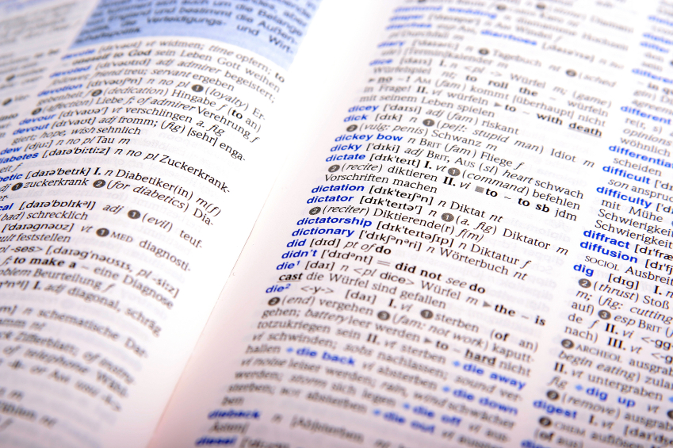
Intercultural Knowledge & Competence Rubric
Definition
Framing Language
Glossary
Notes:
Intercultural Knowledge and Competence is "a set of cognitive, affective, and behavioral skills and characteristics that support effective and appropriate interaction in a variety of cultural contexts.”
The call to integrate intercultural knowledge and competence into the heart of education is an imperative born of seeing ourselves as members of a world community, knowing that we share the future with others. Beyond mere exposure to culturally different others, the campus community requires the capacity to: meaningfully engage those others, place social justice in historical and political context, and put culture at the core of transformative learning. The intercultural knowledge and competence rubric suggests a systematic way to measure our capacity to identify our own cultural patterns, compare and contrast them with others, and adapt empathically and flexibly to unfamiliar ways of being.
The levels of this rubric are informed in part by M. Bennett's Developmental Model of Intercultural Sensitivity (Bennett, M.J. 1993. Towards ethnorelativism: A developmental model of intercultural sensitity. In Education for the intercultural experience, ed. R. M. Paige, 22-71. Yarmouth, ME: Intercultural Press). In addition, the criteria in this rubric are informed in part by D.K. Deardorff's intercultural framework which is the first research-based consensus model of intercultural competence (Deardorff, D.K. 2006. The identification and assessment of intercultural competence as a student outcome of internationalization. Journal of Studies in International Education 10(3): 241-266). It is also important to understand that intercultural knowledge and competence is more complex than what is reflected in this rubric. This rubric identifies six of the key components of intercultural knowledge and competence, but there are other components as identified in the Deardorff model and in other research.
The definitions that follow were developed to clarify terms and concepts used in this rubric only.
Culture: All knowledge and values shared by a group.
Cultural rules and biases: Boundaries within which an individual operates in order to feel a sense of belonging to a society or group, based on the values shared by that society or group.
Empathy: "Empathy is the imaginary participation in another person’s experience, including emotional and intellectual dimensions, by imagining his or her perspective (not by assuming the person’s position)". Bennett, J. 1998. Transition shock: Putting culture shock in perspective. In Basic concepts of intercultural communication, ed. M. Bennett, 215-224. Yarmouth, ME: Intercultural Press.
Intercultural experience: The experience of an interaction with an individual or groups of people whose culture is different from your own.
• Intercultural/cultural differences: The differences in rules, behaviors, communication and biases, based on cultural values that are different from one's own culture.
Suspends judgment in valuing their interactions with culturally different others: Postpones assessment or evaluation (positive or negative) of interactions with people culturally different from one self. Disconnecting from the process of automatic judgment and taking time to reflect on possibly multiple meanings.
Worldview: Worldview is the cognitive and affective lens through which people construe their experiences and make sense of the world around them.

Slide 11
Intercultural Knowledge & Competence Rubric
Knowledge
Skills
Attitudes

Slide 12
Intercultural
Development
Continuum
Monocultural Mindset
Denial
Polarization
Minimization
Acceptance
Adaptation
Intercultural Mindset

Slide 13

Global Learning Rubric
GL Self-Awareness
Perspective Taking
Cultural Diversity
Personal & Social Responsibility
Understanding GL Systems
Applying Knowledge in GL Context

Slide 14


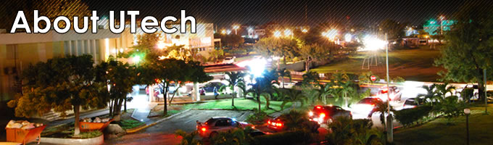
Example: Riding the Bus in Kingston Jamaica

Slide 15
Questions & Discussion

Slide 16
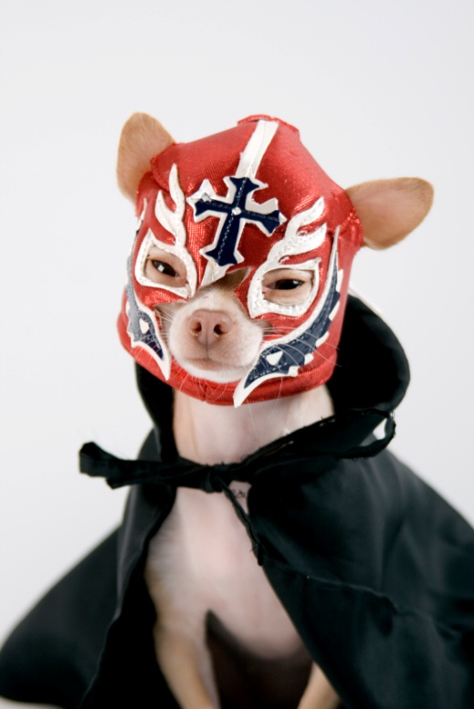
“There is wisdom in
turning as often as
possible from the
familiar to the unfamiliar: it keeps the mind nimble,
it kills prejudice, and it fosters humor.”
-George Santayana, philosopher, (1863-1952)

